Slide 1
Role of Market Surveillance vis-à-vis the placing on the market of Cosmetics
Malta Competition and Consumer Affairs Authority (MCCAA)
Market Surveillance
Technical Regulations Division
Shirley Mifsud
October 2015

Slide 2
Cosmetics
Definition
Substance or mixture intended to be placed in contact with the various external parts of the human body e.g. hair, skin, teeth etc. or with the teeth and the mucous membranes of the oral cavity.
Include: hair dyes, shampoos, make-up, toothpaste etc

Slide 3
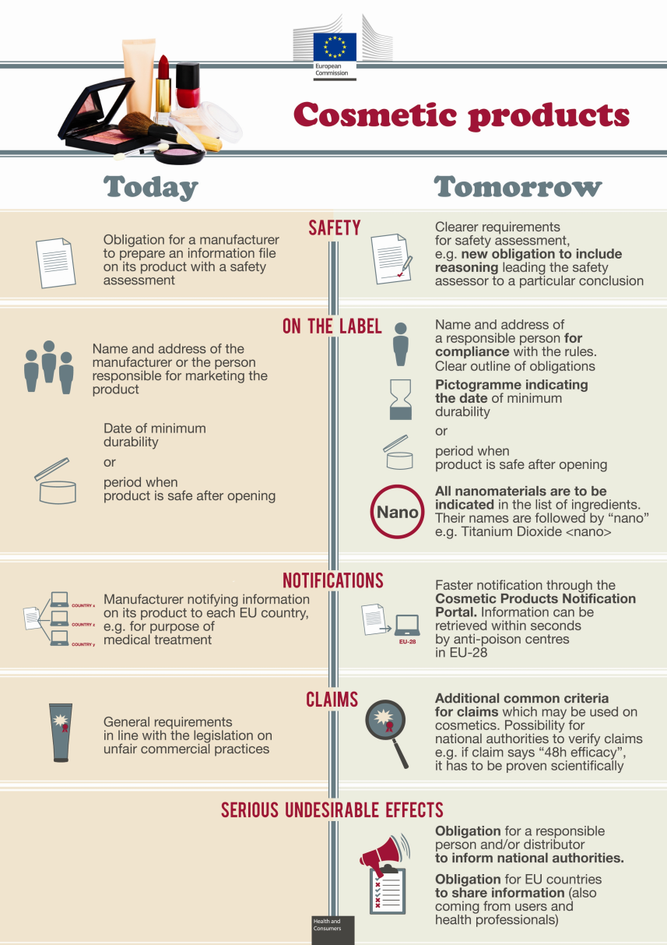
Cosmetics Regulation
Regulation (EC) No 1223/2009 replaces Directive 76/768/EC

Slide 4
Cosmetics Inspections Statistics

Slide 5
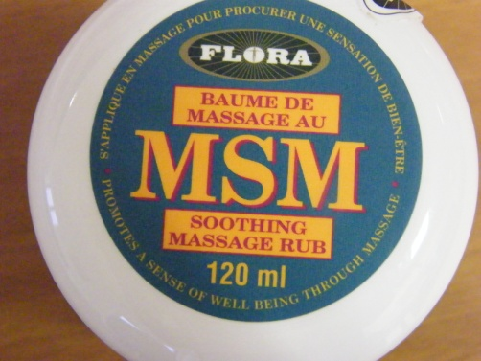
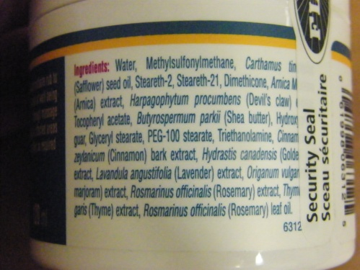
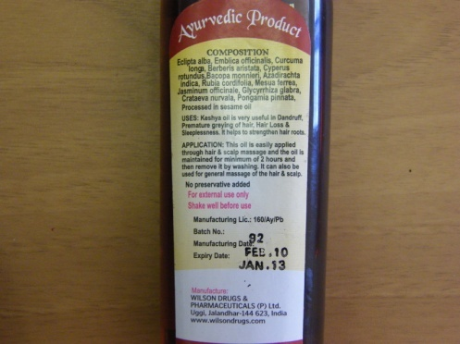
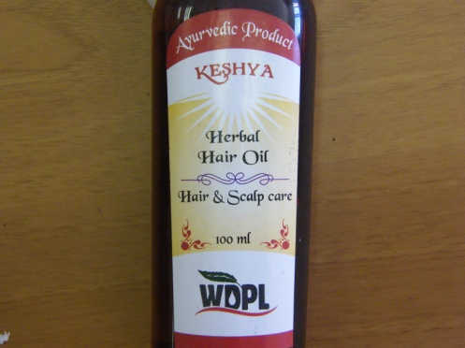
Main problems encountered during inspections
1. Incorrect or incomplete labelling
2. Cosmetics with no EU address/Not Registered in EU

Slide 6
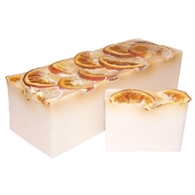
Main problems encountered during inspections
3. Food Imitating cosmetics
4. Counterfeit products (referred to police and/or customs, not in the remit of MCCAA)

Slide 7
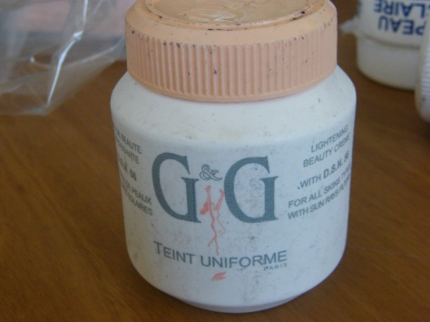
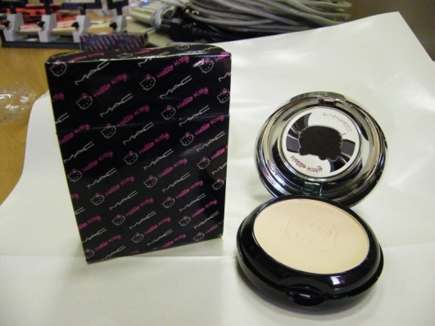
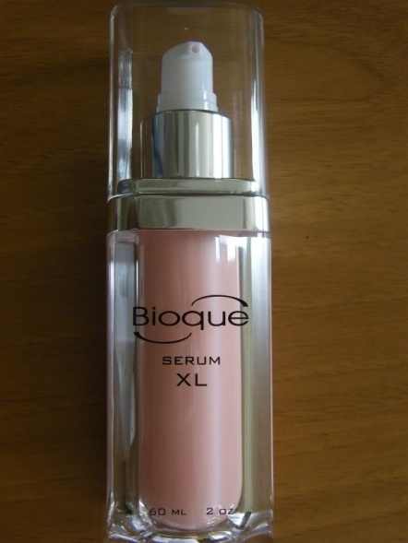
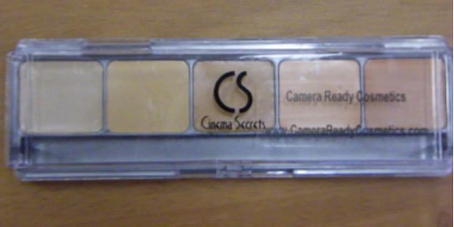
Cooperation between MCCAA and customs
Cosmetics stopped at border and referred to MCCAA officials for further analysis
Yearly average around 50 cases

Slide 8
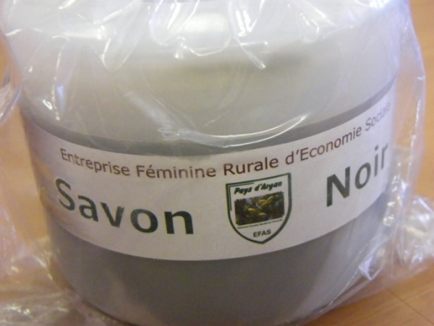
Cooperation between MCCAA and customs
Main issues encountered with products stopped at the border
1. Products entering the EU market for the first time – no registration, no EU address

Slide 9
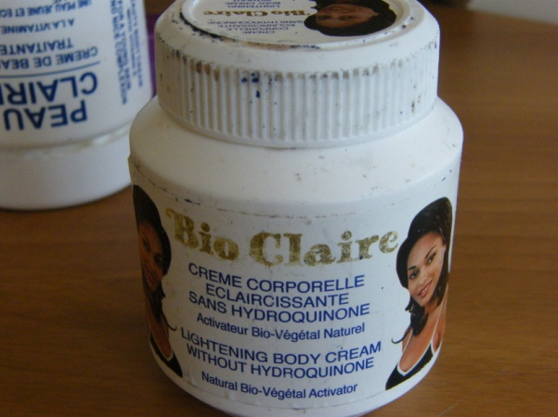
Cooperation between MCCAA and customs
2. Products notified on the RAPEX system as posing a serious risk to consumers
Skin Whitening cream
Contains hydroquinone
Rapex Notification 0086/11
Hair straightening product
High free formaldehyde
Rapex Notification 1252/10

Slide 10
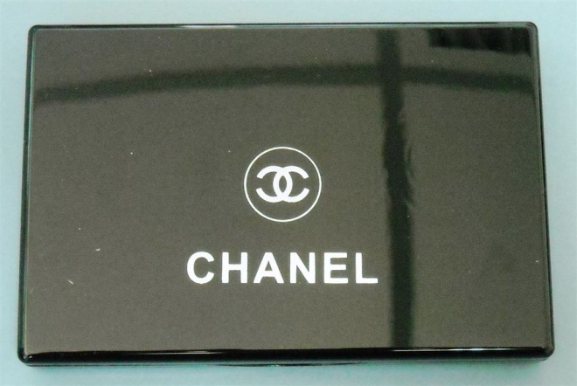
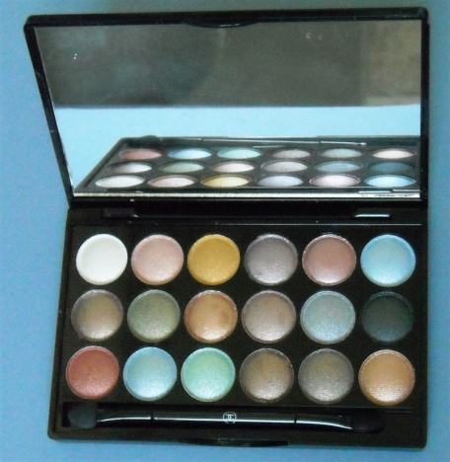
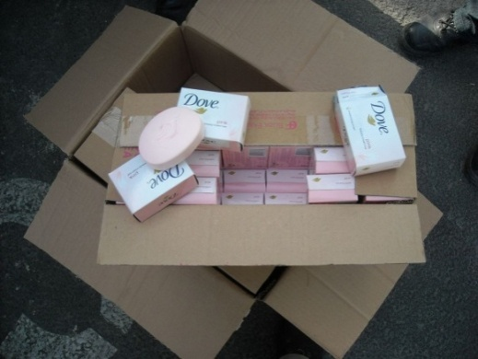
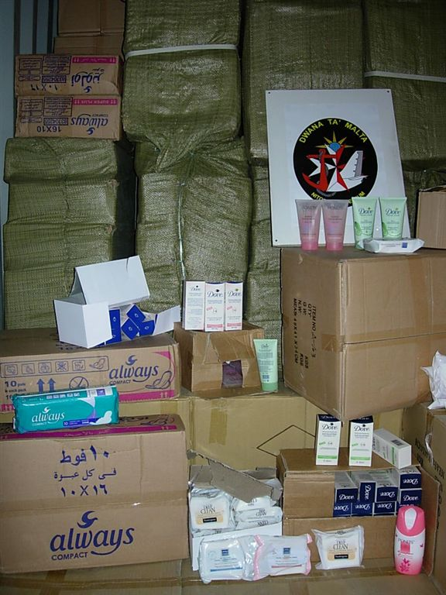
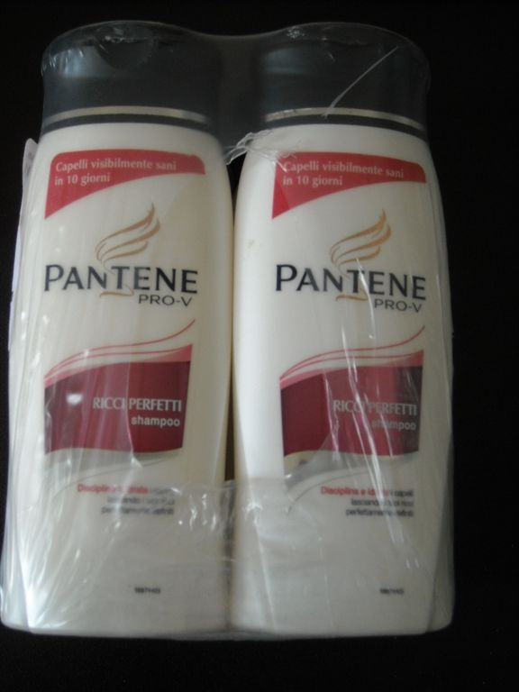
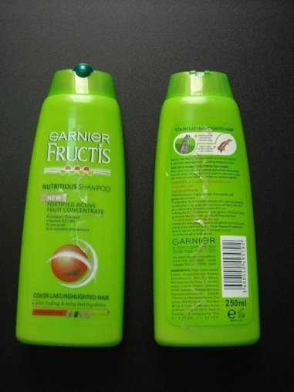
Cooperation between MCCAA and customs
3. Counterfeit products
Make-up and body care products

Slide 11
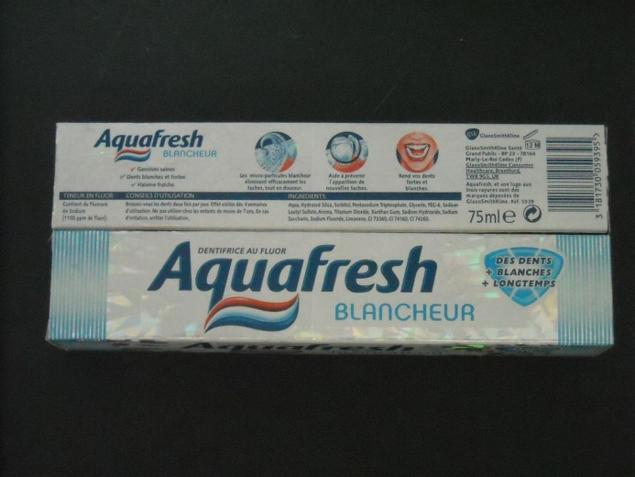
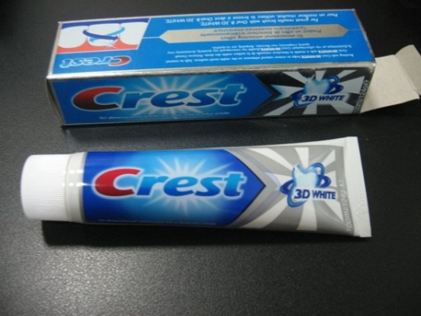
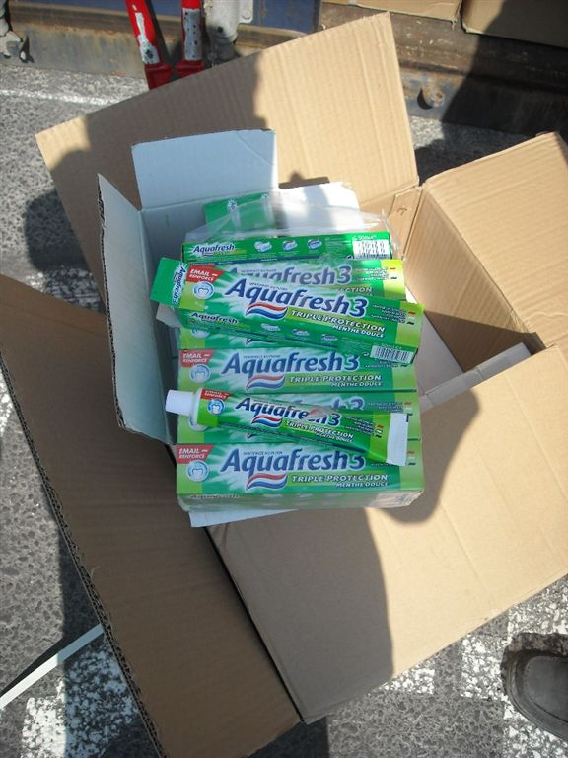
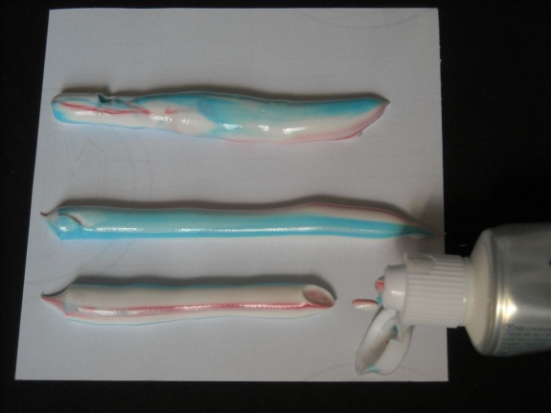
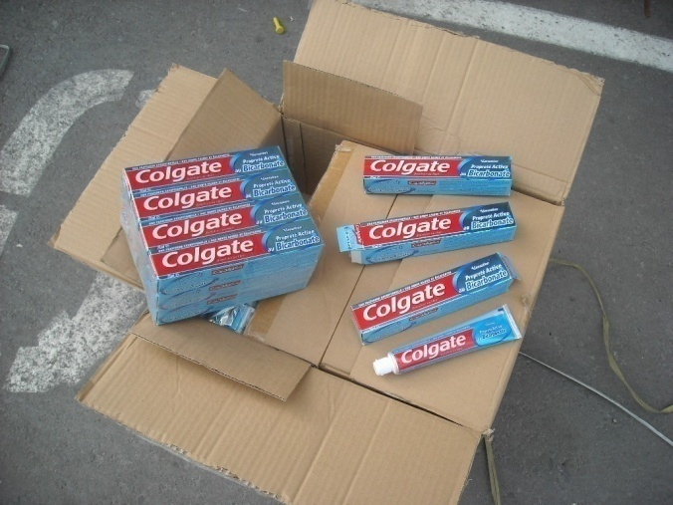
Cooperation between MCCAA and customs
Counterfeit products
Toothpaste

Slide 12
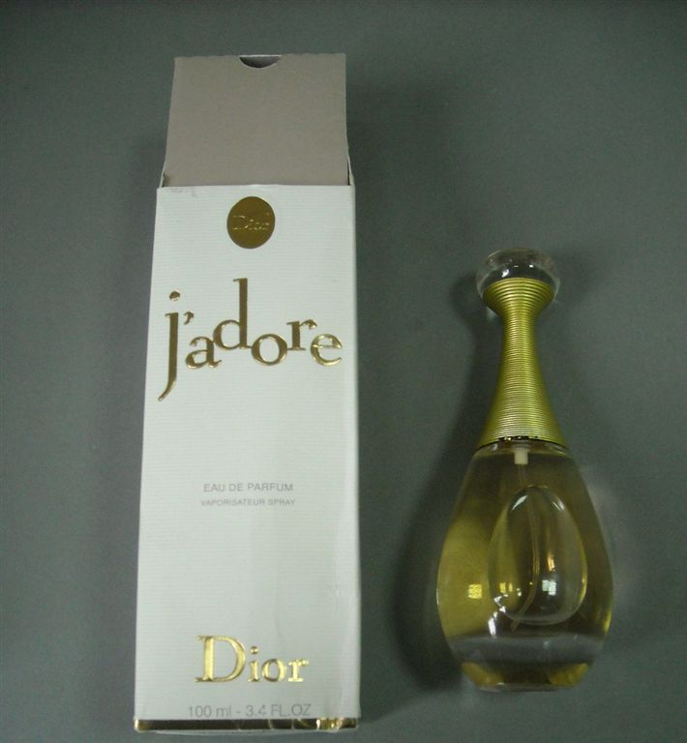
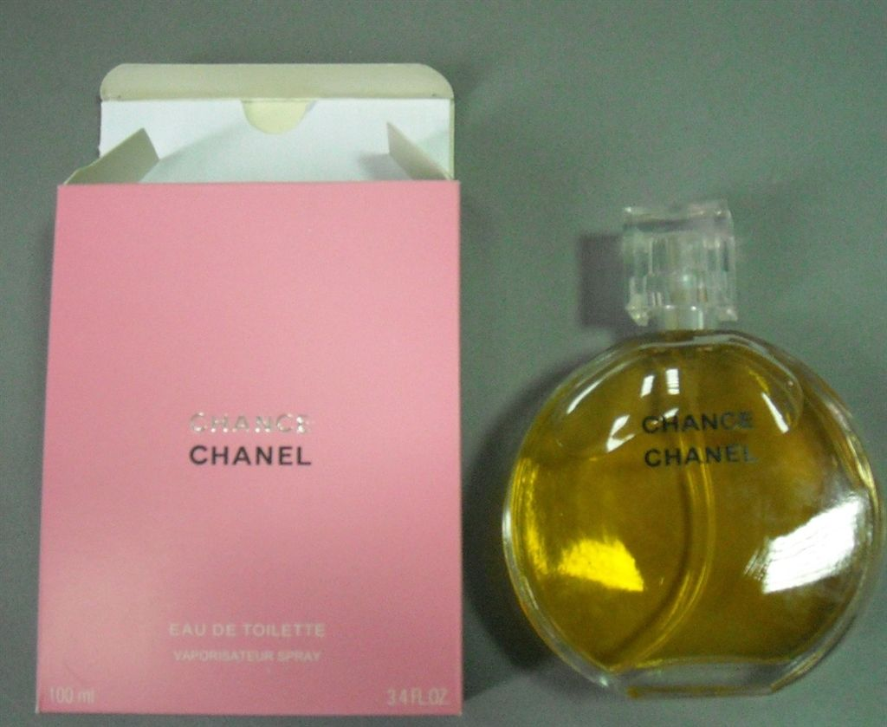
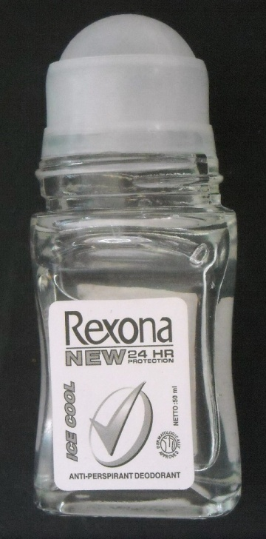
Cooperation between MCCAA and customs
Counterfeit products
Perfumes and deodorants

Slide 13
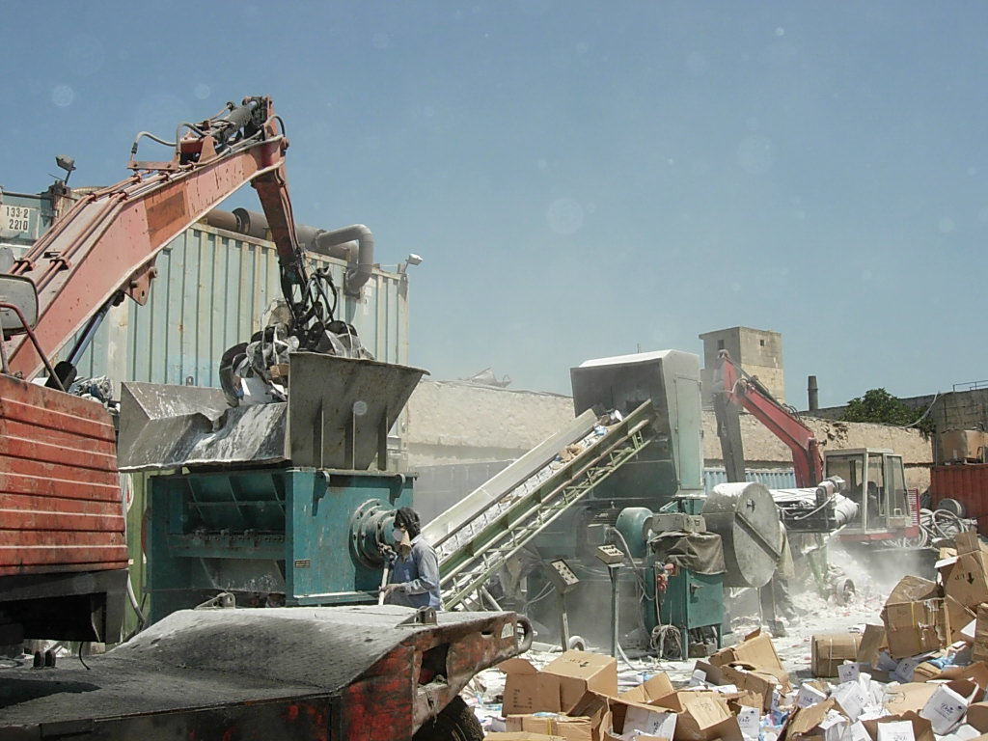
Cooperation between MCCAA and customs
Fate of counterfeit products
Destruction

Slide 14
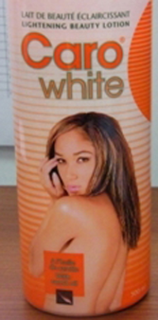
Cosmetics notified by Malta on RAPEX
Year - Week | No. Ref. | Notifying country | Product | Danger | Measures adopted by notifying country
2012 - 22 | 49 0830/12 | Malta | Category: Cosmetics Product: Skin lightening product "Caro White Beauty Lotion" Brand: Caro Type/number of model: Manufactured on 06/11 Expired on 06/13 Batch 8B26443/0 Registration Number 02-6822 Description: Skin lightening beauty lotion. Country of origin: Democratic Republic of Congo | Chemical The product poses a chemical risk because it contains the ingredient hydroquinone, as declared on the label, the use of which is prohibited in cosmetics and personal hygiene products. The product does not comply with the Cosmetics directive 76/768/EEC. | Import rejected by the customs authorities.

Slide 15
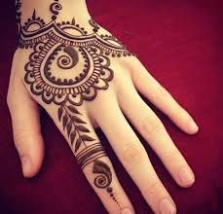
Henna tattoos
Those using pure henna seldom cause any problems and tend to disappear by themselves within a few weeks. However, para-phenylenediamine is sometimes added to the henna for a faster and darker effect, forming so-called 'black henna'

Slide 16
What is black henna?
After painting with pure henna, an orange or chestnut-coloured pattern appears after a few hours. Para-phenylenediamine (PPD) is sometimes added to the henna for a faster and darker effect, forming so-called 'black henna'. Use of this substance is permitted only under strict conditions as a hair dye but not for painting on the skin.

Slide 17
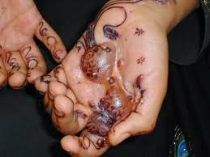
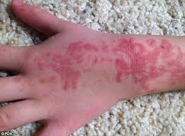
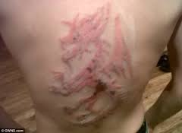
Problems with black Henna
After a few days, allergic reactions can arise: itching, redness, spots, blisters or even permanent discolouring of the skin and scarring. People can also become permanently sensitive to this substance, which is also used in dyes for textiles, rubber, sun filters and some medicines.

Slide 18
Semi/Permanent make-up
Semi/Permanent make-up = Tattoo
Tattoo = the application of ink under the skin therefore NOT a cosmetic
Semi/Permanent make-up artists need to be certified by the Environmental Health Department. Place where such make-up is applied needs to be licensed by the Environmental Health Department.

