Slide 1
Is Consumer Law Still Adequate For its Purpose? Can Challenges Be Resolved? Can Improvement Be Achieved? Lina Caruana Cert. Ed. (Bristol),B.A. (Melit) Dip. Translation and Interpreting , M.A. Sociology (Melit) ACR Executive Committee Member
Consumer means of Redress
10th November 2016
Le Meridien Hotel & SPA St. Julians
European Consumer Centre Malta
in collaboration with the
Malta Competition and Consumer Affairs Authority

Slide 2
Maltese Legislation
Equity and Conscience
Discretion
Precedents become obligatory law

Slide 3
German Civil Code
“A person who through a performance by another or in some other way at the expense of another has received something without any legal ground is bound to make restitution to the other. This obligation arises in the case in which the legal ground later falls away or the result contemplated by the performance as judged by the legal transaction in question fails to materialize”.

Slide 4
Law of Restitution
Multi-causal
Unjust payment
Unjust enrichment and wrongs
Loopholes circling into a vicious circle
Judgement do not separate unjust payment and unjust enrichment and wrongs
Precedents become obligatory Law

Slide 5
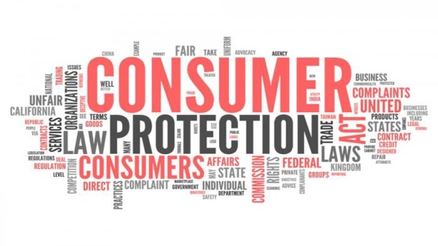
Association for Consumer Rights Malta
The Association for Consumer Rights promotes:
* consumer protection,
* assists consumers in their queries and
* educates the general public through talks,
the ACR website and telephone communication system

Slide 6
Consumers means of redress
Consumers means of redress are often clothed in equity so different approaches depending on a number of reasons including:
interpretation of legislation,
methods of practice and
efficacy of law enforcement,
a consumer’s ability to understand his/her rights and
how to seek redress,
lack of overall information for consumers,
lack of adequate legal advice among others

Slide 7
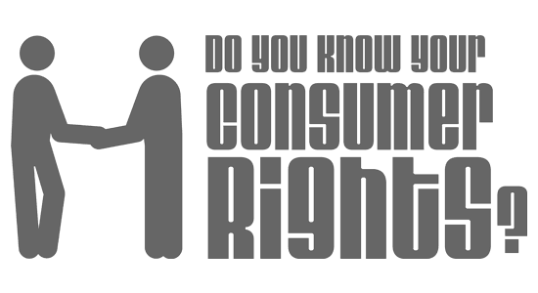
Misleading commercial practices
Misleading commercial practices containing false or inaccurate information are wide and varied

Slide 8
The law states which misleading commercial practices are unfair and prohibited in all circumstances
Falsely claiming to be a signatory to a code of conduct;
Hidden persuasion – that is, inviting customers to purchase products at a specified price without indicating whether he is actually in a position to deliver such goods, or if the trader shows a faulty sample of a product, intending to promote a different product ;
E.g. Falsely claiming that a product is able to cure illnesses;

Slide 9
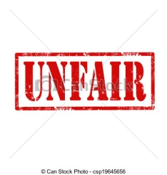
The law states which misleading commercial practices are unfair and prohibited in all circumstances
Describing a product as being “free”, if the consumer has to pay anything it must be stated before hand by the dealer.
Stating or creating the impression that a product can legally be sold when this is not the case;
Seeks payment for a marketed product that the consumer has not ordered.

Slide 10
A recent study by the EU Commission on EU Consumer Law in all 28 Members focused on
Unfair commercial practices and marketing
Contract conclusion and performance
Injunctions
Cross-cutting issues

Slide 11
The Association for Consumer Rights (ACR) noted that:
Effectiveness of Unfair Commercial Practices and marketing depends on empowerment of both the consumer and the organisation representing the consumer
“Black listed dealers” need to be legally reprimanded
Financial services – call for stronger measures to ensure and enforce the giving of accurate information

Slide 12
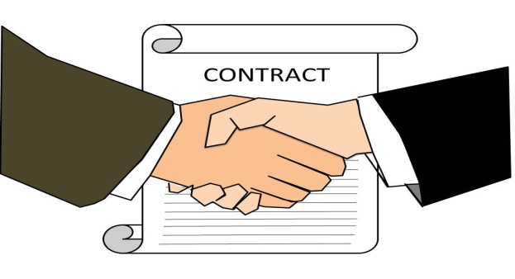
Contract conclusion and performance
Pre-selling contracts need to be clear to provide indicative lists avoiding difficulties in seeking redress

Slide 13
Injunctions
Volkswagen emissions scandal
Telephony bills

Slide 14
Cross-cutting Issues
It is important that consumers be pro-active rather than seek redress as a result of lack of information provided by the seller

Slide 15
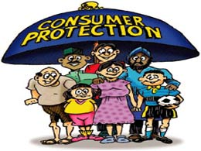
Awareness and protection of consumers
Over all awareness and protection of consumers against unfair commercial practices has increased mainly because of more use of various media which are increasingly becoming providers of information. Empowering the consumer remains vital.

Slide 16
The Digital Agenda
Shop Online Information
• e-mail address of the trader
• any delivery restrictions in certain countries
• the right to cancel the order within 14 days
• available after-sales services
• dispute resolution mechanisms
• trade register number of the trader
• professional title and VAT details of the trader (if applicable)
• professional association to which the trader belongs (if applicable)

Slide 17
Association for Consumer Rights Vision
Cyber Safety awareness campaign

Slide 18
Association for Consumer Rights Malta
This NGO offers help to consumers who need it to seek redress
Domestic appliances guarantee was ignored
The seller refuses to abide by the guarantee
Complaints about leaving a deposit
Problems with return of goods and a credit note for refund
About labelling and specifications

Slide 19
General comments from complaints
There is a need for binding measures
Do sanctions work in practice ?
There is a need for deeper expertise from lawyers to act re precedents by creating new ones ,for these will become law
Hurdles in the Courts of Law can then be improved by lawyers who practice in Consumer Rights
Law enforcement must be emphasized
Actual implementation must take place

Slide 20
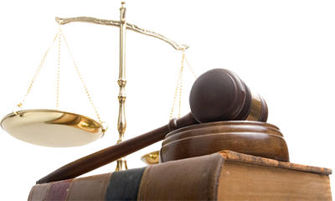
Legal expertise
Lawyers are the best people to debate on the issue and to find solutions accordingly
Their greatest achievement could be if they can manage to break through past precedents and create new ones
This is one way of how the Law can be improved

Slide 21
People are the core of society
It is social action which makes a just or unjust society
Collaboration in the community constitutes a cohesive society
Unjust payment and enrichment at the expense of others contributes towards a corrupt and decadent society

Slide 22
Mode to improve on consumer law
Streamline all the prohibitory and enforcement laws for fair trading in an easily accessible legal instrument which makes it easier for lawyers to curtail the time they spend in searching for a solution

Slide 23
Cross border regulation
Cross border regulation offers more scope for revision as do pricing and other issues concerning clear data to the consumers about specifications and performance for what is being paid for including wrongs arising from it

Slide 24
CONCLUSION
Action should not simply be limited by the everyday concerns of a disappointed consumer but through these narratives we need to see how both the consumer and the seller respond to each other. This calls for appropriate sociological studies about the behaviour of the consumer, the seller and the dynamics of supply and demand in an expanding economy

Slide 25
Consumer Law Still Adequate For its Purpose? Can Challenges Be Resolved? Can Improvement Be Achieved?
Lina Caruana Lina Caruana Cert. Ed. (Bristol),
B.A. (Melit) Dip. Translation and Interpreting (Melit) , M.A. Sociology (Melit) ACR Executive Committee Member

