Slide 1
Shopping online? Yes, you can have more peace of mind!
Market Surveillance Directorate
Technical Regulations Division

Slide 2
Shopping online- The questions
But I do not know the trader?
And how can I be sure what product I will receive?
How can I be certain whether the product complies with requirements?
This product is cheaper than the one I saw in the shop. So how can it not be a good bargain?
And what about risks? Can the product I ordered pose a serious risk to the person it is intended for?
Would the product be suitable for the parameters we have in Malta? (e.g. electrical earthing)

Slide 3
5 easy steps
to follow for greater
peace of mind!!!

Slide 4
Step 1- Ensure suitability of the product to its intended recipient/use
Check:
target age
- e.g. toys for children under 3yrs of age. Toys which contain detachable parts and
small parts should be marked as unsuitable for children under 36months;
whether recipient knows how to handle product:
- e.g. if item is an electrical product, laser products for consumers must not be more than Class 2;
if product is fit for purpose
- e.g. cosmetics might contain banned substances,
whether product requires authorisation prior to entry into the EU
- e.g. biocides require prior authorisation.

Slide 5
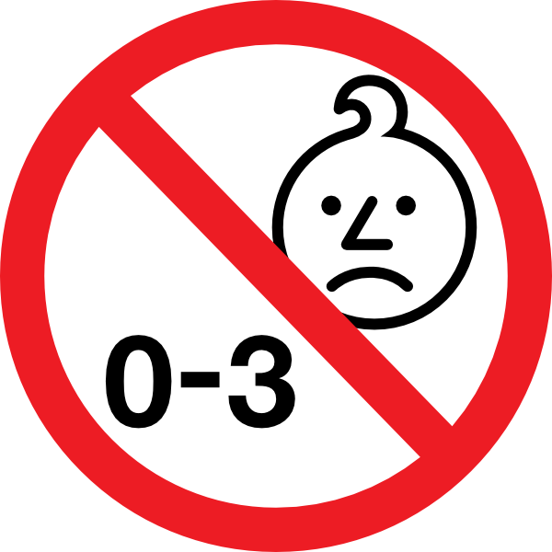
Step 1 (contd)- Ensure suitability of the product

Slide 6
Step 2- Does product need specific requirements for entry into the EU?
Does product require:
CE Marking? – e.g. toys, construction products, electrical products;
Authorisation prior to introducing it into the EU? – e.g. ppps.
Language and other requirements on labels? – e.g. cosmetic products in INCI code.
Manufacturer’s authorised representative in the EU? – e.g. medical devices
DOC accompanying the product? – e.g. machinery product

Slide 7
Step 2 (contd)- Specific requirements for entry into the EU?

Slide 8
Step 3- Check whether there are possible issues with the product?
Check whether:
the product you intend buying has been listed on RAPEX as unsafe;
any online reviews posted by consumers, on media or on social media;
authenticity of product – Brand Name - An unbranded product cannot be
placed on the market
it looks very similar to a product of a popular brand name. In this case it may be counterfeit.

Slide 9
Step 3 (contd)- Are there possible issues with the product?

Slide 10
Step 4- Check the information/conditions related to the product
Check whether:
the product requires energy labelling especially for white goods;
the product requires labelling as caution/warning signs when product is
used. Any specific hazard should be drawn to consumer’s attention;
the product has the safety instructions, such as for electrical toys, tools, detergents, cosmetics and medical devices;
the product has had any recalls, bad reviews or articles posted online.
the product is suitable for use in Malta, such as electrical products connected to mains supply.

Slide 11
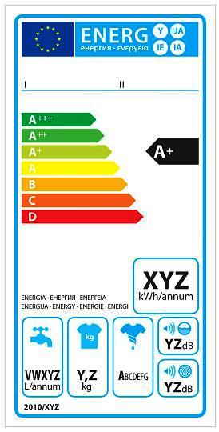
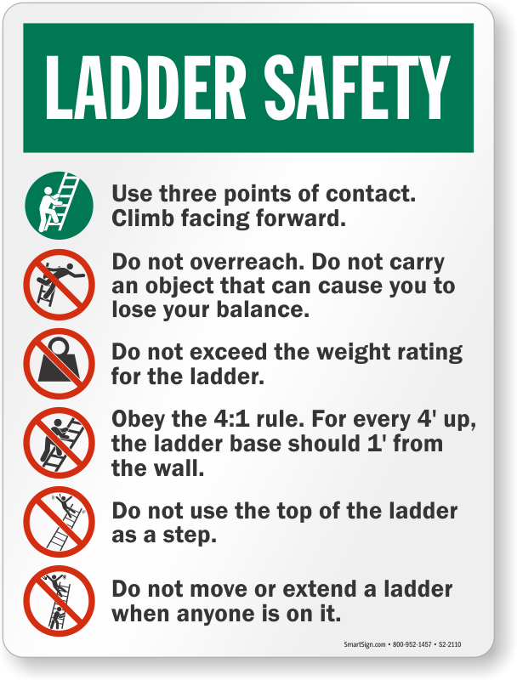
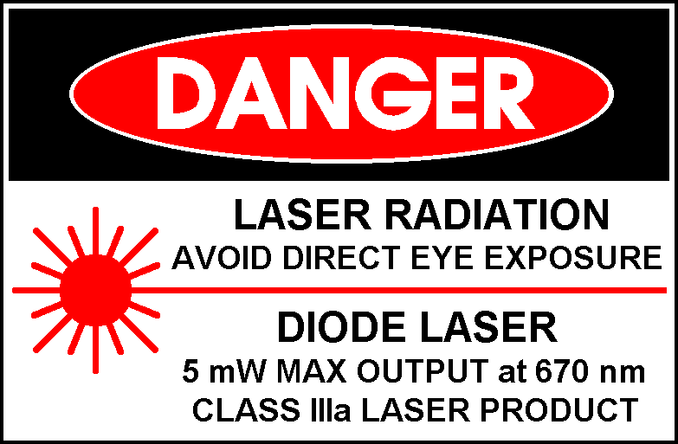
Step 4 (contd)- Information related to the product

Slide 12
Step 5 -
After you have done your homework,
if still in doubt,
ask Questions
and
ask the MCCAA.
We are here to help.
But we consumers should know our rights and stand up to them.

Slide 13
Rapex notifications from Malta
 | Notifications | For Info | Reactions
2012 | 29 | 12 | 40
2013 | 14 | 11 | 36
2014 | 12* | 7 | 38
2015 | 23 | 20 | 45
2016 | 28 | 7 | 64
2017 | 24 | 6 | 69

Slide 14
Thank you for your attention.
Ing. Michael Cassar
Director
Market Surveillance Directorate
Email: michael.b.cassar@mccaa.org.mt
Tel: 23952310

