Slide 1

Safeguarding Consumers in the Digital World
Grace Stivala
Director (Enforcement)
Office for Consumer Affairs

Slide 2
Office for Consumer Affairs
Information, Education and Research Directorate
Disseminates information and creates awareness on the rights and responsibilities of both consumers and traders
Complaints and Conciliation Directorate
assists consumers and provides mediation between consumers and traders
Enforcement Directorate
ensures compliance to consumer protection legislation

Slide 3
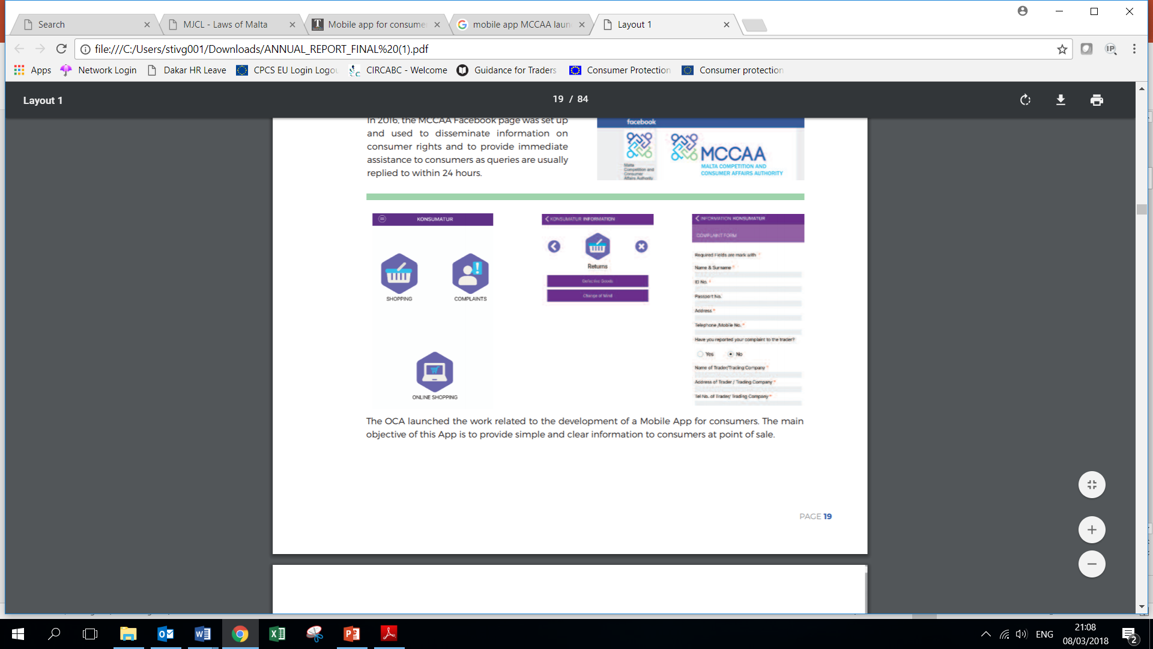

Our role in the digital world
The ‘Konsumatur’ App
Service with a Smile Award
Talks, articles and programmes focusing on online shopping and on
how consumers can safeguard their financial interests
Addresses complaints emanating from online shopping by Maltese
residents from local sellers and complaints received through the online dispute resolution platform
Carries out enforcement actions relative to online shopping for both tangible goods and services
Participates fully in the Consumer Protection Cooperation Network

Slide 4
The Consumer Protection Cooperation Network
Regulation (EC) No 2006/2004 on consumer protection cooperation lays down a cooperation framework to allow national authorities in the EU to jointly address breaches of consumer rules when the trader and the consumer are established in different countries
The national authorities form a European enforcement network called the "CPC Network"
The European Commission coordinates the cooperation between the authorities to ensure that consumer rights legislation is applied and enforced in a consistent manner across the Single Market

Slide 5
How the CPC Network works
The Consumer Protection Cooperation Regulation sets a list of minimum powers to ensure a smooth cooperation
Any authority in a country where consumers' rights are being violated can ask its counterpart in the country where the trader is based to take action to stop this breach of law
The CPCS is the IT Tool established to facilitate cooperation and to provide a structured and secure communication channel for the exchange of information between public enforcement authorities
Authorities can also alert each other about malpractices that could spread to other countries
Authorities, with the Commission's support, can also coordinate their approach to applying consumer protection law so as to tackle widespread infringements

Slide 6
EU Wide Screening of websites (Sweeps)
A ‘sweep’ is a set of checks carried out simultaneously by national enforcement authorities to identify breaches of EU consumer law in a particular sector
Sweeps operate in a two-step action process, comprising of a coordinated sweep action and the enforcement phase
In the enforcement phase, the authorities ask the traders concerned to take corrective action

Slide 7
2014 Sweep
Commercial and Legal Guarantees
437 websites selling electronic goods were checked out of which 235 were found to be infringing EU Consumer law
Main issues identified:
insufficient information about the legal guarantee
lack of accessibility or transparency of conditions of the commercial guarantee

Slide 8
2015 Sweep
Pre-contractual information as regulated by the Consumer Rights Directive
743 websites were checked and irregularities were confirmed in 436 cases. The majority of these cases were corrected.
Main issues identified:
poor information on the right to withdraw from a transaction
incomplete or unclear details about the trader
failure to provide clear information of price or contract conditions
unclear information on product or service characteristics

Slide 9
2016 Sweep
Screening of travel comparison and booking websites
352 websites comparing offers and prices, mainly in the travel sector were checked. 117 were flagged for further investigations. The majority of these cases were corrected and some are still ongoing.
Main issues identified:
irregularities related to the price and the way it was calculated and presented
limited information on the identity of the provider of the comparison tool
unclear or non-transparent information on the user review process
lack of information on the comparison criteria

Slide 10
Joint Actions
In-app purchases (2013)
Main problems identified:
games advertised as “free”
direct exhortations to children
payment arrangements
email address of traders
Google and Apple made a number of engagements to address the above problems. This action increased consumer confidence in the fast-growing "app" sector

Slide 11
Joint Actions
Social Media (2016)
Duty of social media operators to provide an email address and to cooperate with consumer protection authorities – Notice and action procedure
Fairness or lack of clarity of some "Standard Terms"
Jurisdiction, applicable law clause and waiver of mandatory consumer rights
Failure to identify commercial communications
Consumer's obligation to indemnify the provider and waiver by the provider of all liability
Removal of user generated content
Power to unilaterally change terms and conditions
Power to unilaterally determine the scope and application of the terms and conditions

Slide 12
Joint Actions
Social media operators specifically agreed to implement the changes to their terms in all language versions in the first quarter of 2018:
the terms of services limiting or totally excluding the liability of social media networks in connection with the performance of the service;
the terms requiring consumers to waive mandatory EU consumer rights, such as their right to withdraw from an on-line purchase;
the terms depriving consumers of their right to go to court in their Member State of residence, and providing the application of California law;
the term releasing the platform from the duty to identify commercial communications and sponsored content

Slide 13
E-Enforcement Group
Set up in 2013 to address the rapidly evolving commercial practices and business models in e- and m-commerce such that e-enforcers are able to detect new trends in time, keep pace with technical and internet law developments and share knowledge quickly.
The CPC e-enforcement group’s areas of work are:
Horizon scanning
Best Practice
Training
Knowledge exchange

Slide 14
E-Enforcement Academy
a branch of the e-enforcement group
an e-learning service to support the knowledge and capacity building in internet investigations
keeps the users informed about the challenges of ecommerce, develop digital skills and create common tools and methods to improve the online market surveillance and enforcement actions in the digital single market.
a whole community of colleagues and experts ready to share their views, experiences and discuss the new online trade challenges.
Knowledge webinars, e-learning webinars, basic and advanced coaching webinars, Internet Researcher’s Manual, Master Classes and assistance

Slide 15
New CPC Regulation
New minimum investigative and enforcement powers, including:
the power to purchase goods or services as test purchases, where necessary, under a cover identity
the power to remove content or to restrict access to an online interface or to order the explicit display of a warning to consumers when they access an online interface;
the power to order a hosting service provider to remove, disable or restrict access to an online website
The power for European Consumer Centres, consumer organisations and associations, and where appropriate trader associations to issue external alerts.

Slide 16
New upcoming package proposal
New Deal for Consumers
aimed at ensuring cheaper and more effective means to stop and remedy breaches harming multiple EU consumers simultaneously
Two legislative acts:
A Directive introducing targeted amendments to several substantive consumer law Directives
A Directive amending and replacing the 2009 Injunctions Directive, with a view to including elements of collective consumer redress.

Slide 17
THANK YOU
grace.stivala@mccaa.org.mt

