Slide 1
The European Consumer Centres Network (ECC-Net)
Consumer Information and Redress: The role of the ECCs
Dr. Phyllis Bezzina
15.03.2018

Slide 2
Aim of the ECC NET
Promote confidence in the Internal market by advising citizens on their consumer rights and by providing easy access to redress

Slide 3
What we do?
Provide information
Give advice & assistance
Help resolving cross-border complaints & disputes
Support in all practical cross-border consumer issues

Slide 4
Geographical scope
1
centre
for every EU Member State,
Iceland & Norway
=
centres
30

Slide 5
Our mission
The centres co-operate to settle complaints and disputes between consumers and traders based in other EU member states by providing free assistance and advice to consumers.

Slide 6
Our mission
Reaching an Out of Court amicable settlement between the parties

Slide 7
Our mission
… as part of safeguarding the collective interests for consumers:
Cooperation with enforcement bodies
Observatory & relay on the well functioning of the Internal market
Feedback to national & EU stakeholders involved in consumer protection through case-handling experience
Information campaigns across the Network
Joint projects and reports

Slide 8
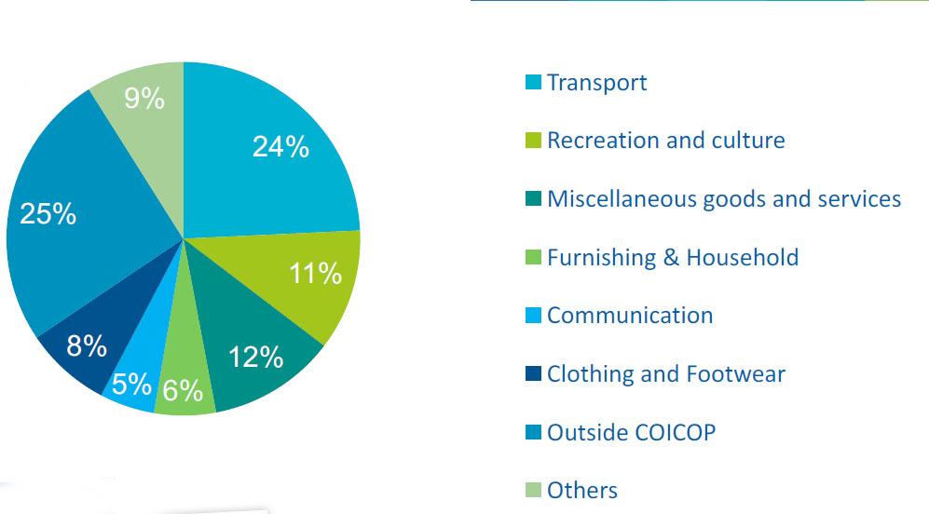
Contacts from consumers in 2017
In total 52,017 requests for information were registered across all 30 Centres.
To every information request the ECC-Net provides information on EU consumer rights.

Slide 9
No of Complaints
26%
E-Commerce related 35,307
Others 12,350
Total 47,657
74%
E-Commerce: The buying and selling of goods and services over an electronic network/the internet

Slide 10
Role of the ECC Net in enforcement of legislation
The Network supports enforcement authorities by providing evidence.
Example - Car Rental Sector: Dialogue between CPC-Net and the 5 biggest car rental companies in 2015.
The ECCs documented the main problems consumers had in the car rental sector. This built up the evidence that fed into the initiative.
The new CPC Regulation: Article 27 - ECCs to have the power to issue external alerts to competent authorities of suspected infringements covered by the Regulation.
The new CPC Regulation: Article 27 - ECCs to have the power to issue external alerts to competent authorities of suspected infringements covered by the Regulation.
Notes:
The Network supports enforcement authorities by providing evidence. As an example, in the car rental sector, the ECCs documented the main problems consumers had in the car rental sector. This built up evidence that fed into the dialogue between the Consumer Protection Cooperation Network (CPC) and the 5 biggest car rental companies.

Slide 11
Role of the ECC Net in enforcement of legislation
Other joint tools to enhance co-operation with stakeholders.
CPC- ECC Monitor – a forum of discussion and exchange of information, regarding companies which feature a lot in the complaints handled by the ECCs and are causing problems to consumers
The aim of this tool is for the ECCs to enhance the discussions with enforcement authorities and continue gathering cases of collective consumer interest and communicate them to the CPC-Net via the tool.
ECCs highlight the types of complaint and a form is sent to the CPC.

Slide 12
Role of the ECC Net in enforcement of legislation
Classification of companies according to the nature of goods/services sold
Some examples:
subscription traps – in this context, the means of targeting consumers evolve, with social media messages and pop ups becoming more common
Ticket reselling – ECCs receive complaints of companies targeting the EU market
Virtual currencies – this new topic of complaints have started to appear with various ECCs
Digital services – for instance, companies belonging to the dating sector and travel services
Other services including car rental

Slide 13
ECCs in the digital single market
Precisely to provide the personalised assistance to European consumers to help them understand and benefit from the constantly new services and marketing techniques becoming available in the digital markets.
Examples of joint projects undertaken by the network:
Fraud in cross-border e-commerce – examined problems reported to the Network by individual consumers. Providing practical tips & advice to consumers on how to avoid falling victims of scams.
Enhanced Consumer Protection – The Services Directive ECC – Net analysed typical situations where consumers were confronted with different treatment or refusal to sell or provide a service on the basis of nationality or place of residence - eg. Redirection of websites & different prices in different countries.

Slide 14
ECCs in the digital single market
Empowering consumers by increasing the awareness of consumer rights.
Examples of joint projects undertaken by the network:
Subscription traps - ‘Consumers must oppose online traps’.
Intrusive marketing offering free trials or cheap deals – social media/pop ups. Luring consumers into making impulse buys.
‘The impact of counterfeiting on online consumer rights in Europe’ – tips on how to avoid buying such goods.

Slide 15
Finding the best dispute resolution solution
Nature of Consumer Claims –
Consumer hesitate to engage in litigation in relation to small value claims.
Court procedures tend to be too complex and expensive.
ECC’s role is to point consumers in the right direction of the dispute resolution mechanism applicable to the complaint in question.

Slide 16
Out of Court Dispute Resolution
Out-of-court Dispute Resolution
settles disputes
Different systems across the EU
mediation | conciliation | ombudsmen | arbitration | complaint board | etc.
Different set-ups
public | private | public-private partnerships | etc.
simple
fast
less expensive

Slide 17
Out of Court Dispute Resolution
The ADR-Directive ensures consumer access to ADR regardless of
Quality control
Binding requirements - authorities evaluate & notify ADR-bodies to the European Commission
The online form of ADR is called
Online Dispute Resolution (ODR)
the purchased product / service*
online or offline purchases
the trader’s establishment in the consumer’s residence country
*except health & higher education

Slide 18
ODR Platform
How to find the competent ADR body?
Regulation (EU) No 524/2013 (ODR-Regulation) provides for an ODR-platform on which notified consumer ADRs are listed.
http://ec.europa.eu/odr/
The Platform serves as a single point of entry for consumers and traders seeking the out-of-court resolution of disputes covered by the Regulation.
The Platform links the National ADR entities notified by the Member States.
The ODR Regulation applies to out-of-court resolution of disputes concerning contractual obligations stemming from online sales or services contracts between consumers and traders resident and established within the EU through the intervention of an ADR entity.
Collective interest of consumers can still be a general problem

Slide 19
Online Dispute Resolution Platform
ODR Contact Points
22 ECCs act as Contact Points for the ODR
Main Functions of the ODR Contact Points
Provide information on the functioning of the platform
Assist in the submission of complaints
Provide general information on consumer rights and/or other means of redress
Provide explanations on the specific procedure applied by the proposed ADR entities
Collective interest of consumers can still be a general problem

Slide 20
European Small Claims Procedure
What is this procedure?
A Court procedure aimed to settle cross-border disputes in cases involving €5000 or less.
Non-monetary claims can also be made under this procedure
The Small Claims Tribunal has the jurisdiction to hear and determine such claims in Malta
Collective interest of consumers can still be a general problem

Slide 21
European Small Claims Procedure
Advantages of the ESCP
It aims to improve access to justice by simplifying small claims litigation such as consumer claims
Applies also to business to business transactions
It is a relatively cheap procedure
The procedure is conducted totally in writing although an oral hearing may be requested
Following the procedure, a judgment is delivered
Collective interest of consumers can still be a general problem

Slide 22
Thank you for your attention!
Follow us on
European Consumer Centre Malta
@ECC_malta

